Slide 1

SQL E-COMMERCE SALES PROJECT
Analyze customer behavior, product sales, and order trends using SQL.

Slide 2
SQL: The Backbone for Data Analysts
Data Access & Querying SQL lets analysts retrieve specific data quickly from large databases.
Data Aggregation & Reporting Easily summarize metrics using functions like SUM(), AVG(), GROUP BY.
Combining Multiple Data Sources Join multiple tables using JOIN to create meaningful insights.
Data Cleaning & Transformation Perform filtering, sorting, and transformation of data with clauses like WHERE, CASE, ORDER BY.
Foundation for Advanced Tools Powers BI tools like Tableau, Power BI, Excel – often SQL is the source layer.

Slide 3
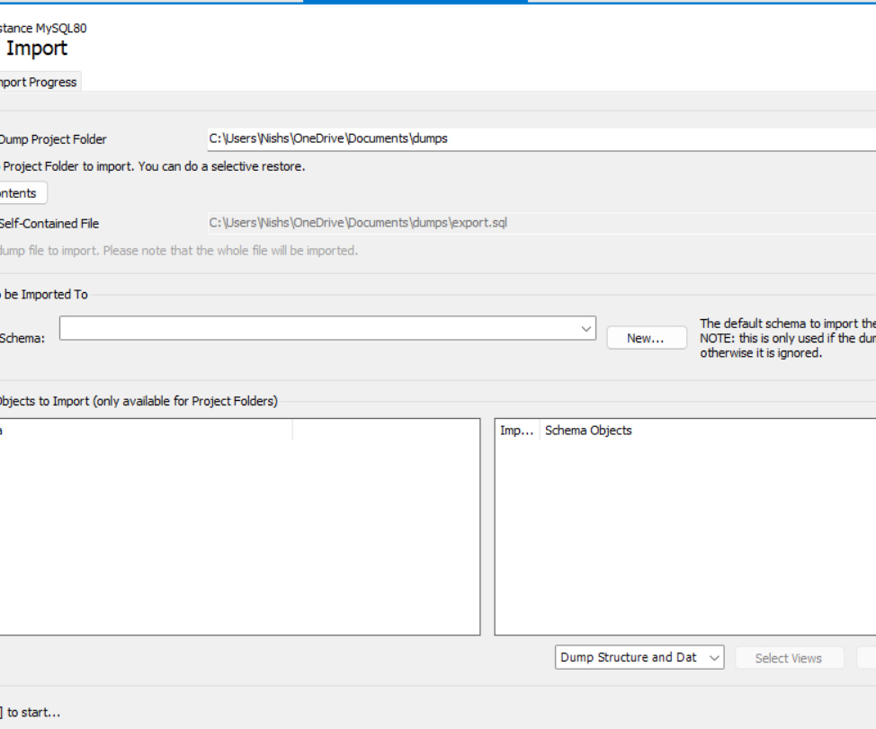
Steps to create this project:-
1.Imports all the Excel files (.csv) to MySQL workbench
Open MySQL workbench > Select new Query tab > go and select server option > Click on Data Import.
You will get a new window like this:-

Slide 4
Steps to create this project:-
2. Select import from self contained file and browse your files.
3. Create a new Database and use it.
4. Check all the data once at MS – Excel in case any null values there. (Optional)
5. Once everything done come to MySQL workbench and start writing queries and get output.

Slide 5
DATASETS:-
Get Dataset from mine Github profile
iNish27/E-Commerce-sales: This is a mine first SQL project
Check my Project on LinkedIn
https://www.linkedin.com/in/nishant-sharma-0141ba360/

Slide 6
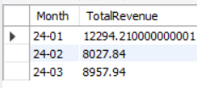
Total Revenue Per Month
Select date_format(OrderDate, '%y-%m') as Month,
sum(TotalAmount) as TotalRevenue
from Orders
Group by month
order by Month;

Slide 7
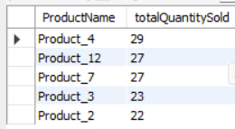
Top 5 best-selling products by quantity
Select products.ProductName, sum(order_details.Quantity) as totalQuantitySold
from order_details Inner Join products
on order_details.ProductID = products.ProductID
Group by products.ProductName
order by totalQuantitySold desc
Limit 5;

Slide 8
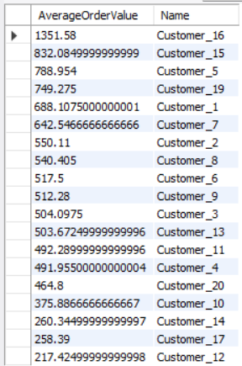
Average order value per customer
Select avg(orders.TotalAmount) as AverageOrderValue,
customers.Name
from customers inner join orders
on orders.CustomerID = customers.CustomerID
group by customers.Name
order by AverageOrdervalue desc;

Slide 9

Gender-based revenue contribution
Select customers.Gender, Sum(orders.TotalAmount)
as TotalRevenue
from customers inner join orders
on customers.CustomerID = orders.CustomerID
group by customers.Gender;

Slide 10
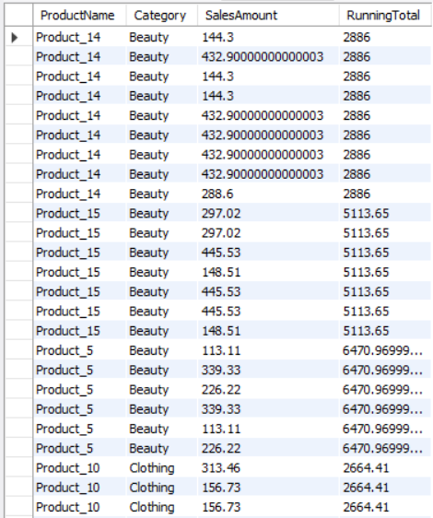
Running total of sales per category
Select products.ProductName, products.Category,
order_details.Quantity * order_details.UnitPrice as SalesAmount,
sum(order_details.Quantity * order_details.UnitPrice)
over (partition by products.Category Order by products.ProductName)
as RunningTotal
from order_details inner Join products on
products.ProductID = order_details.ProductID;

Slide 11

Products never sold
SELECT p.ProductID, p.ProductName
FROM products p
LEFT JOIN
order_details od ON p.ProductID = od.ProductID
WHERE
od.ProductID IS NULL;
No output because there is no any product which does not get sold.

Slide 12
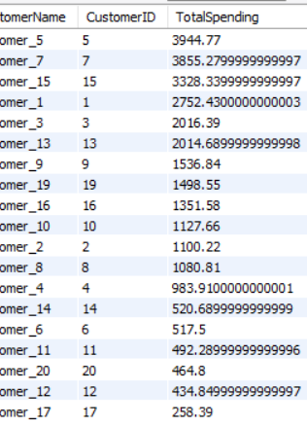
Use RANK() to find top customers by spending
Select customers.Name as CustomerName, customers.CustomerID,
sum(orders.TotalAmount) as TotalSpending,
Rank () over (order by sum(orders.TotalAmount) desc) as SpendingRank
from customers inner join orders on
customers.CustomerID = orders.CustomerID
group by
customers.CustomerID, customers.Name
order by
SpendingRank;

Slide 13
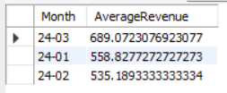
Use a CTE to calculate average monthly revenue
WITH cteAvgMonthlyRevenue AS (
SELECT
DATE_FORMAT(OrderDate, '%y-%m') AS Month,
AVG(TotalAmount) AS AverageRevenue
FROM orders
GROUP BY
DATE_FORMAT(OrderDate, '%y-%m’)
)
SELECT * FROM cteAvgMonthlyRevenue;

